Slide 1
Analysis Assumptions
Ticket Count taken for CBK Store
Total 585 Closed tickets data is analyzed for the period of 4 months April – July 2013.
Data was taken from the following file ( Excel File)

Slide 2
Basic Statistics
Avg time to Triage = 2 hrs = 0.25 days (p: Service Time ) 0.25
Avg time to resolve = 1 day
Bottleneck is at Triaging the issue ( Once identified 1 resource will resolve the issue in average 1-2 days)
Avg tickets rate= 583 tickets / 124 days 4.701612903 (4.7 tickets / day) = Flow Rate 0.212692967 (Ticket in unit time)
Std Deviation in the flow of incoming tickets 0.534652656
Coeff of Variation (Tickets): 2.51
Coeff of Variation in processing: 1

Slide 3
Overall Analysis-Criticality Wise
Application Criticality | Number of Application
P1 | 61
P2 | 86
P3 | 436
Total | 583
<The above Pie chart to be redone>

Slide 4
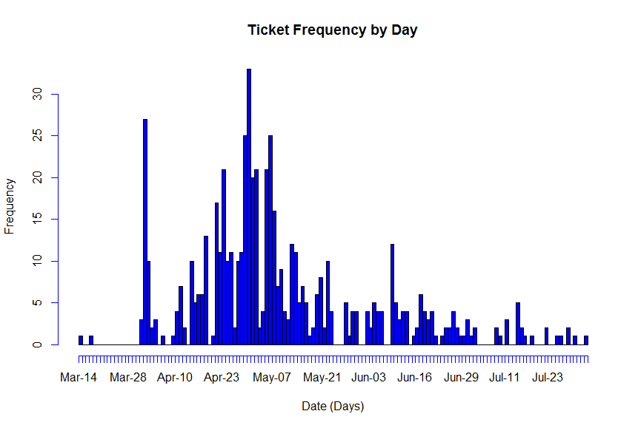
Overall Analysis-Flow of Tickets
There is a peak of 25-30 tickets / day / store
The transient phase of production tickets lasts for about 30 days before settling down at steady state of 5 tickets/day

Slide 5
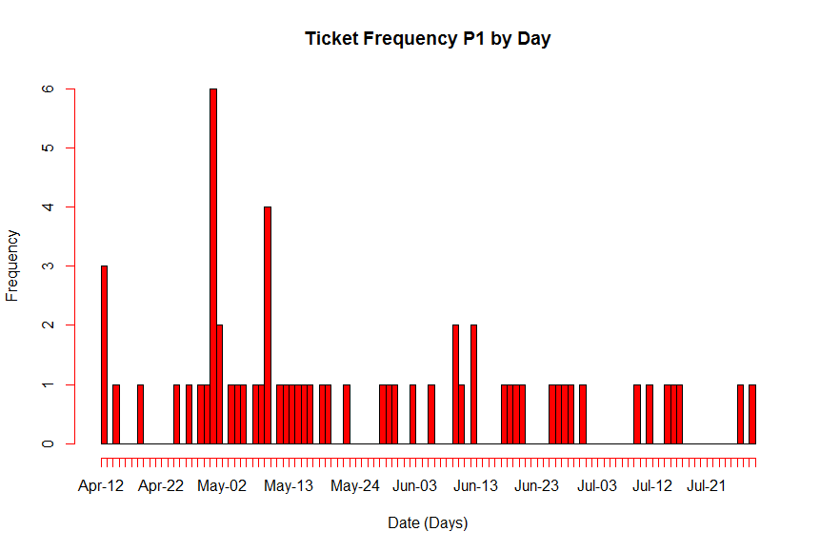
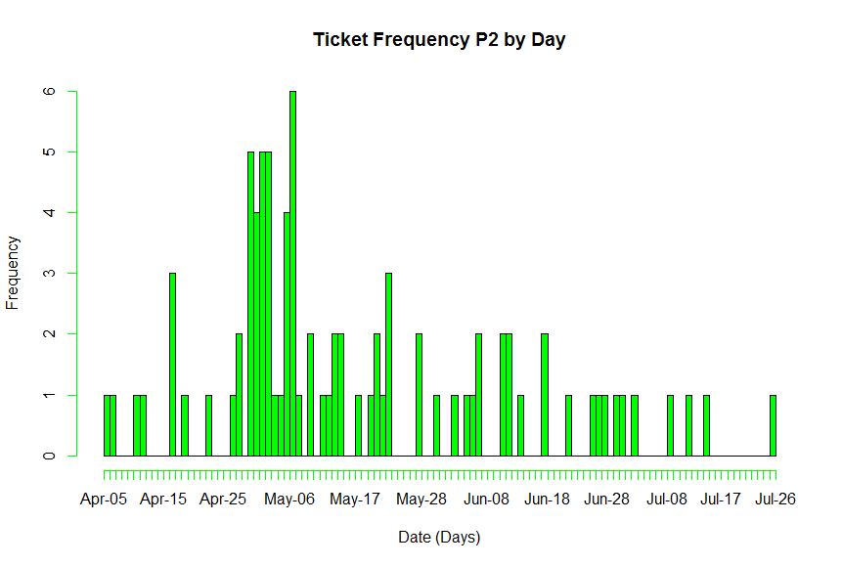
Overall Analysis-P1 v/s P2 Tickets
P1 peaks to about 4-6 tickets / day during transient stage, and settles at around 1/day/store in steady state
P2 also peaks at about 4-6 tickets /day during transients and settles at 1-2 tickets /day / store in steady state

Slide 6
Solving for Wait Times through Operations Research: Optimizing the Use of Capacity
One Store Analysis
Resources assumed: 7 ( for a 24x7 support)
Implied utilization: 67%
Wait Time (Days): 0.34
Wait Time (Hrs): ~ 3 hrs
Two - Store Analysis
Resources assumed: 11 ( for a 24x7 support)
Implied utilization: 85%
Wait Time (Days): 1.08
Wait Time (Hrs): ~ 8 hrs
To meet SLA of 24 hrs and 24x7 Support , a minimum of 11 reources will be required in the operations

